Slide 1

Topic 10:
Other Strategies for Active Learning
Course Design Institute 2022

Slide 2

Serving Others

Slide 3

More Active Learning
Collaborative learning, problem-based, and project-based learning are proven and viable strategies to increase student engagement.
Next, let’s consider Civic Engagement, Service-Learning, and Practical Experience.

Slide 4
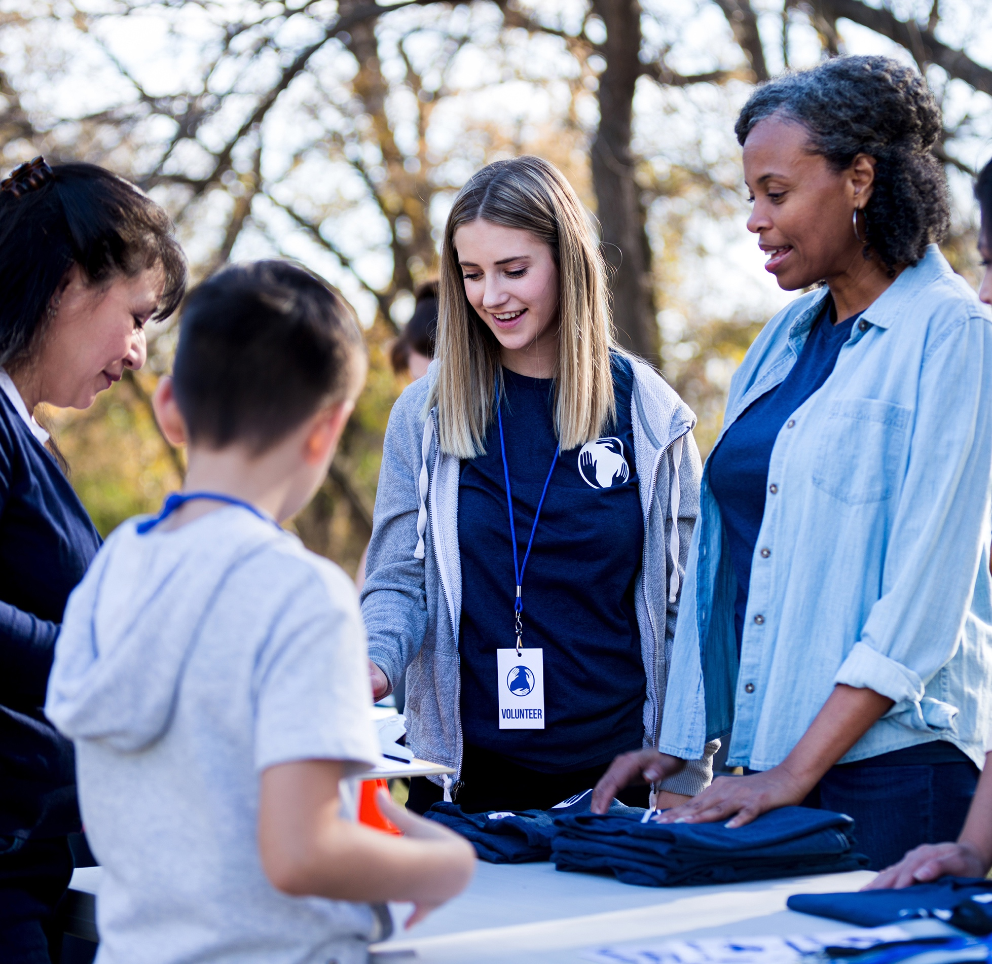
Civic Engagement / Service Learning
Both civic engagement and service learning connect the student with the community in some capacity.
Tasks assigned in problem-based or project-based learning often involve engagement in the community-based or service-oriented learning opportunities.
Civic engagement or service learning can co-exist or overlap with collaborative pedagogies.

Slide 5

Examples
One-time group service projects
Optional course component
Required course component
Action Research Project
Capstone Project
Multi-course project (spanning sequential semesters or involving students from multiple courses at the same time)

Slide 6

Preparing for Civic Engagement or Service Learning
Identify and establish a relationship with a community partner, determining through open discussion how your students can best meet one or more of their needs or serve their target population meaningfully.
Write outcomes and objectives for your course that students will achieve through their involvement in the planned learning experience.
Address any ethical issues that may pertain to your project, ensuring the just and benevolent treatment of all persons involved. You may need to work with your institution’s IRB to be certain that requirements have been satisfied.

Slide 7

Logistics for Civic Engagement or Service Learning
Determine how you will handle issues such as:
  Transportation of students or project materials to and from the work site
  Liability concerns, including drivers’ licenses or insurance for those providing transportation
  Media coverage, either by informing the local media of the project, creating posts to social media, or publicizing the project through campus communication channels
  Clarifying the roles of all participants and providing for student supervision and oversight
  Scheduling the project, creating a master calendar and agendas for each meeting, maximizing participants’ time while at the job site
  Training or orientation that might be required by the partner organization before students can engage in the project
  Establishing contingency plans for when things don’t go as expected and proper procedures for handling emergencies

Slide 8

Managing Civic Engagement or Service Learning
Express any expectations and assumptions so that students, community partners, and faculty all understand what they will gain from the project.
Participants should also verbalize any concerns so that these can be addressed before they become problematic.
Incorporate all necessary information, documentation, and written materials in the course’s design, include them in the syllabus, and provide them to all participants.

Slide 9

Managing Civic Engagement or Service Learning - 2
Explain required training, the work to be performed, what will occur after the completion of the project
Inform students about broad issues related to the project such as the demographics and histories of the target population, including contextualization such as discussions of power and inequality
Communicate all planned activities related to the project, calendars, schedules, and logistical information
Incorporate instruction in problem solving, critical thinking, analysis, application, theorization, and reflection
Plan for how you will assess student learning and how you will assign grades for students’ involvement in the project

Slide 10

Managing Civic Engagement or Service Learning - 3
Communicate regularly with the partnering organization, visit the project site, monitor progress, and ensure that students are functioning appropriately within the project setting.
Incorporate separate opportunities for debriefing and reflection for students and participants in the partnering organization, allowing each person to think critically about their experience, relate it to larger social contexts and issues, recognize their involvement in the project’s challenges and successes, and prepare for future engagement.

Slide 11

Practical Experience – Internships
Internships often involve a short-term, usually part-time, position with a company or organization related to a student’s field of study.
These generally last from two or three months to an entire semester or even a full academic year.
Interns usually function as employees of the organization, with designated duties and some level of responsibility.
Interns may receive pay or a stipend, but this varies depending on many factors. It is not unusual for an internship to lead to permanent employment, since employers are able to witness the student’s work ethic and job-related skills.
This Photo by Unknown Author is licensed under CC BY-NC

Slide 12

Practical Experience – Externships
Externships also involve a student in a practical work experience but are shorter in duration, lasting anywhere from a day to a week or occurring over the summer or spring break.
Externships are usually unpaid and often consist of workplace observations or job-shadowing.

Slide 13

Practical Experience – Co-Op
Co-operative education (co-op) is a specialized type of internship that provides career training with pay as students work with professionals in their major field of study.
Depending on the field, a co-op placement may necessitate that the student take a semester or more away from their studies, since these can be full-time paid positions.

Slide 14

Practical Experience – Volunteering
Volunteer work related to a student’s field of study can also expose students to practical experience in your discipline.
Co-curricular or community-based organizations abound, and most are eager for volunteers.
Most campuses or their surrounding communities offer many volunteer opportunities.

Slide 15

Prepare for Externships
Identify and build a relationship with community partners willing to host externship students for one-day job shadowing.
Provide students with a list of these organizations and information for a contact person with whom the student must schedule their experience, or work with the partner organization(s) to create a schedule and assign students to given days.

Slide 16

Prepare for Volunteering
Create a list of possible volunteer options related to the purposes of your course.
Inform students of the requirement that they select and work with one of these organizations during the semester and create a means by which the student will report on this experience.
The syllabus should clearly state each detail of this requirement and how it will be assessed.

Slide 17

Student-Led Job Shadowing or Volunteering
Require students to identify and conduct their own job shadowing or volunteer experience while on an extended break from school (generally over Thanksgiving or Spring Break).
Students must make these contacts on their own, undertake the experience, and then create documentation to show that they have met the requirement.
Again, the syllabus should clearly state each detail of this requirement and how it will be assessed.

Slide 18


Study Abroad
https://www.dailymail.co.uk/femail/article-5259681/Study-40-Americans-never-left-country.html
Study abroad programs are not really a strategy we can apply in our classrooms, but they are a subset of active learning that we can promote to our students.
A 2018 market study revealed some surprising statistics.
  13% of Americans have never flown in an airplane
  50% don’t own a passport
  40% have never left the country
  11% have never traveled outside their home state
  54% have visited 10 states or less
  32% don’t own travel luggage
A study abroad program may be some students’ only opportunity to expand their horizons and deepen their knowledge of other cultures through international travel, meeting degree program requirements or electives while also enriching their perspective by encountering people and places outside their everyday experiences.

Slide 19
Engaged, Meaningful, Relevant
It’s one thing to sit in a classroom and listen to someone talk about human needs or problems. Going out into the community to work with people in need is an entirely different learning experience.
People learn best when they can apply their learning to real-world settings and when what they’re learning is personally meaningful and relevant.
Civic engagement, service-learning, community-based learning, and practical engagement opportunities such as internships, externships, volunteering, and study abroad all broaden students’ learning beyond the walls of the classroom.
The more we can infuse our curriculum with meaningful connections to the real world that give our students the chance to make a difference, the stronger their educational experience will be.

Slide 20

Topic 10 Task – Ideation for Active Learning
Use the Topic 10 Worksheet to consider how you might add other active learning strategies to the course you’re designing.
Share your ideas with someone nearby.

